Slide 1
Capstone Project
Book-Recommendation System Swen Fereira

Slide 2

Table of Contents:
● Introduction
● Problem Statement
● Data Overview
● Data Preparation for k-Nearest Neighbors Model
● Exploratory Data Analysis
● Model Creation k-Nearest Neighbor
● Data Preparation for SVD Model
● Model Creation SVD
● Model Evaluation
● Conclusion
● Challenges

Slide 3
Introduction:
● Recommender systems are machine learning systems that help users discover
new product and services
● A recommendation system helps an organization to create loyal customers and
build trust by them desired products and services for which they came on your
site.
● A book recommendation system is a type of recommendation system where
we have to recommend similar books to the reader based on his/her interest.
● The books recommendation system is used by online websites which provide
ebooks like google play books, open library, goodReads, etc.

Slide 4
Problem Statement:
● During the last few decades, with the rise of Youtube, Amazon, Netflix, and many
other such web services, recommender systems have taken more and more place
in our lives. From e-commerce (suggest to buyers articles that could interest them)
to online advertisement (suggest to users the right contents, matching their
preferences), recommender systems are today unavoidable in our daily online
journeys.
● In a very general way, recommender systems are algorithms aimed at suggesting
relevant items to users (items being movies to watch, text to read, products to buy,
or anything else depending on industries).
● Recommender systems are really critical in some industries as they can generate a
huge amount of income when they are efficient or also be a way to stand out
significantly from competitors. The main objective is to create a book
recommendation system for users.

Slide 5
Data Overview:
The Book-Crossing dataset comprises 3 files.
1. Users:
Contains the users. Note that user IDs (User-ID) have been anonymized and map to
integers. Demographic data is provided (Location, Age) if available. Otherwise, these fields
contain NULL values.
● Data set Contains ‘User-ID’ , ‘Location’, ‘Age’ information’s.
● The Data set Contains 278858 Rows
2. Ratings:
Contains the book rating information. Ratings (Book-Rating) are either explicit, expressed on a scale from 1-10 (higher values denoting higher appreciation), or implicit, expressed by 0.
● Data set Contains ‘User-ID’ , ‘ISBN’, ‘Book-Ratings’ information’s.
● The Data set Contains 1149780 Rows

Slide 6
Data Overview(Continued...):
3. Books:
Books are identified by their respective ISBN. Invalid ISBNs have already been removed from the dataset. Moreover, some content-based information is given (Book-Title,Book-Author, Year-Of-Publication, Publisher), obtained from Amazon Web Services. Note that in the case of several authors, only the first is provided. URLs linking to cover images are also given, appearing in three different flavors (Image-URL-S, Image-URL-M, Image-URL-L), i.e., small, medium, large. These URLs point to the Amazon website.
● Data set Contains 'ISBN', 'Book-Title', 'Book-Author', 'Year-Of-Publication', 'Publisher', 'Image-
URL-S', 'Image-URL-M', 'Image-URL-L‘ information’s.
● The Data set Contains 271354 Rows.

Slide 7
Data Preparation for k-Nearest Neighbor Model:
● We will take only those users who rate on minimum 200 books.
● We will consider only those books which are rated by at least 50 users.
Observations:
● We are getting observation from here that 278858 people had rated on
1149780 Books but out of this only 905 people have given rating on 527556
Books.
● This tells us that most people do not rate.
● That's why we removed them from the data.
● Our final Data Frame contains only 194280 rows.

Slide 8
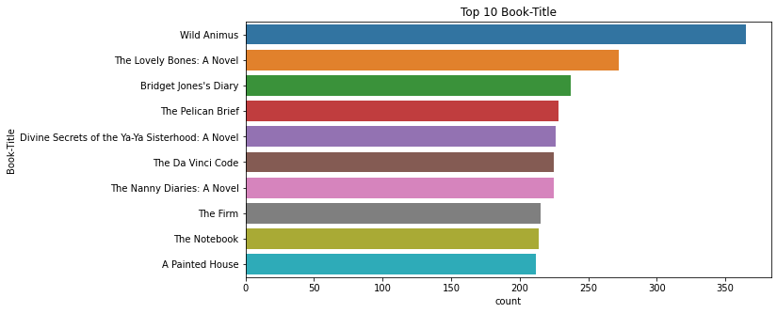
Exploratory Data Analysis:
Top 10 Books:
● We have 8061 unique Book Title.
● The top most book title found is
Wild Animus.
● Wild Animus is present in 365
rows.

Slide 9
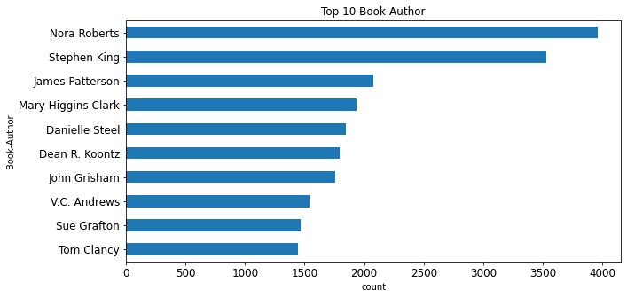
Exploratory Data Analysis:
Top 10 Book Authors:
● We have 4249 unique Authors.
● The top most author found is
Nora Roberts.
● 3958 Books written By Nora
Roberts

Slide 10
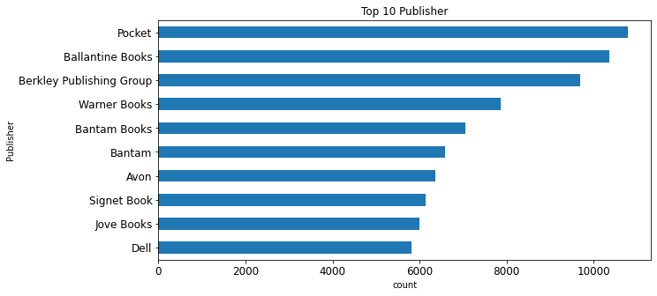
Exploratory Data Analysis:
Top 10 Book Publishers:
● We have 1075 unique
Publishers.
● The top most Publisher
found is Pocket.
● 10786 Books Published
By Pocket.

Slide 11
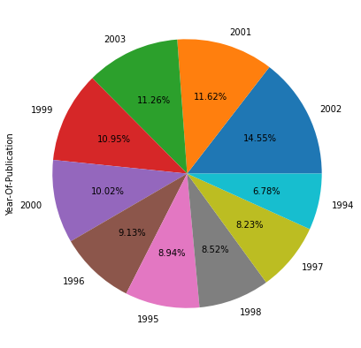
Exploratory Data Analysis:
Year of Publication:
Most books were published in the year of 2002.

Slide 12
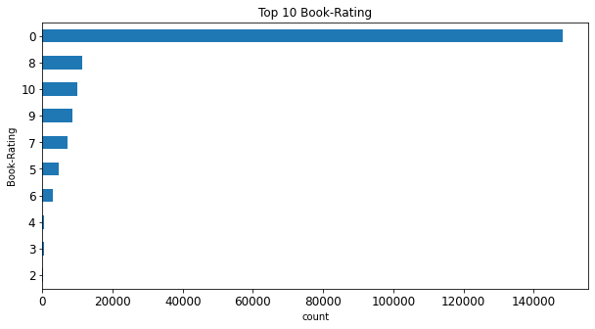
Exploratory Data Analysis:
Book Ratings:
● Highest rating is 8 out of 10.
● Lowest rating is 1 out of 10.
● Most of the people haven't given
the ratings.

Slide 13
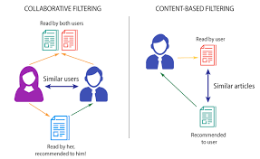
Model Creation:
Recommendation system is usually classified on rating estimation:
➢Collaborative Filtering system.
➢Content based system.
➢Hybrid based system.

Slide 14
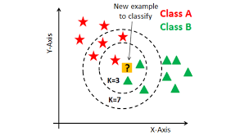
Collaborative Filtering Using k-Nearest Neighbors (kNN)
kNN is a machine learning algorithm to find clusters of similar users based on common book ratings, and make predictions using the average rating of top-k nearest neighbors.

Slide 15


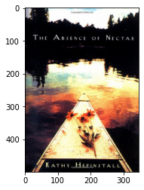


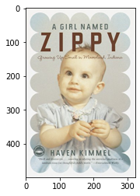
Result of K-Nearest Neighbour:
Target Book: Recommendations:

Slide 16
Data Preparation for SVD Model:
● We are Considering only those ratings that are not equal to 0
● Filter Users with atleast 20 interaction
● Filter Books(ISBN) with atleast 10 Ratings
Observations:
● After Dropping 0 Ratings, remaining rows are 433671.
● After Filtering out Users with at least 20 interaction & Books(ISBN) with at least
10 Ratings, remaining rows are 72385.

Slide 17
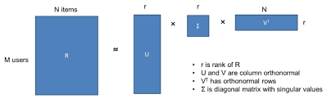
Collaborative Filtering Using Singular Value Decomposition (SVD):
●The Singular-Value Decomposition, is a matrix decomposition method for
reducing a matrix to its constituent parts in order to make certain
subsequent matrix calculations simpler. It provides another way to factorize
a matrix, into singularvectors and singular values.

Slide 18
Evaluation:
In Recommender Systems, there are a set metrics commonly used for evaluation. We choose to work with Top-N accuracy metrics, which evaluates the accuracy of the top recommendations provided to a user, comparing to the items the user has actually interacted in test set. This evaluation method works as follows:
1. For each user.
2. For each item the user has interacted in test set.
3. Sample 100 other items the user has never interacted.
4. Ask the recommender model to produce a ranked list of recommended items,
from a set composed of one interacted item and the 100 non-interacted items.
5. Compute the Top-N accuracy metrics for this user and interacted item from the recommendations ranked list.
6. Aggregate the global Top-N accuracy metrics.

Slide 19
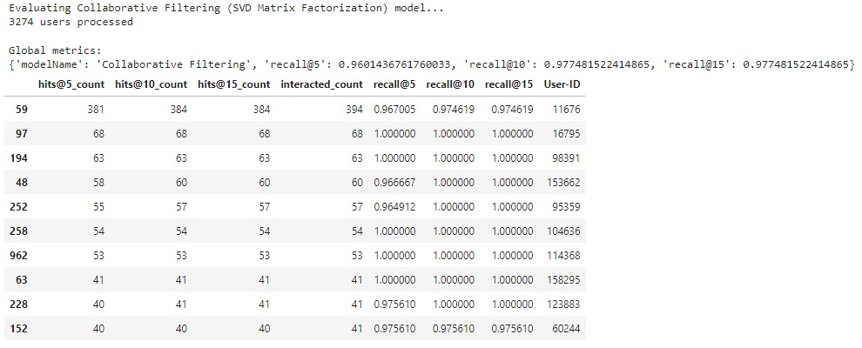
Evaluation (Continued...)

Slide 20
Conclusion:
● A recommendation system helps an organization to create loyal customers .
● The recommendation system today are very powerful that they can handle the new
customer too who has visited the site for the first time.
● They recommend the products which are currently trending or highly rated and
they can also recommend the products which bring maximum profit to the
company.
● A book recommendation system is a type of recommendation system where we
have to recommend similar type of books to the reader based on his interest. The
books recommendation system is used by online websites which provide ebooks
like google play books, open library, good Read’s, etc.
● As we can see, after implementing Collaborative Filtering and evaluating it using
SVD matrix , We got a recall rate of around 97 for hit@15 is pretty good.

Slide 21
Challenges:
➢High Volume of Data.
➢Elevating evaluation score for the models.
➢Choosing optimal number of books and ratings.
➢Crashing of session due to large pivot matrix.
➢Choosing optimal number of Factors in SVD.

Slide 22

This Photo by Unknown Author is licensed under CC BY-NC-ND

